Slide 1
Raychat Cyber Security Incident
Shreya, Fanxin, Angel, Linting, Yuxin

Slide 2
Overview and Remediations
P A R T 0 1

Slide 3
Overview
P A R T 0 1
Raychat data breach; a communications application based in Iran
How was the data breached?
Date: January 2021
Origin: Server misconfiguration
Impact: Exposure of hundreds of millions of accounts
Data Accessed: User data across accounts
Aftermath: Hacker claimed responsibility on a forum
Affected Files: 150 million user files compromised
Total Accounts in Database: Nearly 300 million
Leaked Data Included: Full names, IP and email addresses, Bcrypt-encrypted passwords, Telegram IDs.
Breach Method: Misconfigured server leading to exposed data.
Hacker's Action: Downloaded the entire database through the vulnerability.
Discovery: IT security researcher found the exposed database.
Content: Database contained extensive user information.
Company Alert: Despite attempts to notify Raychat, a bot attack destroyed the data before they could respond.

Slide 4
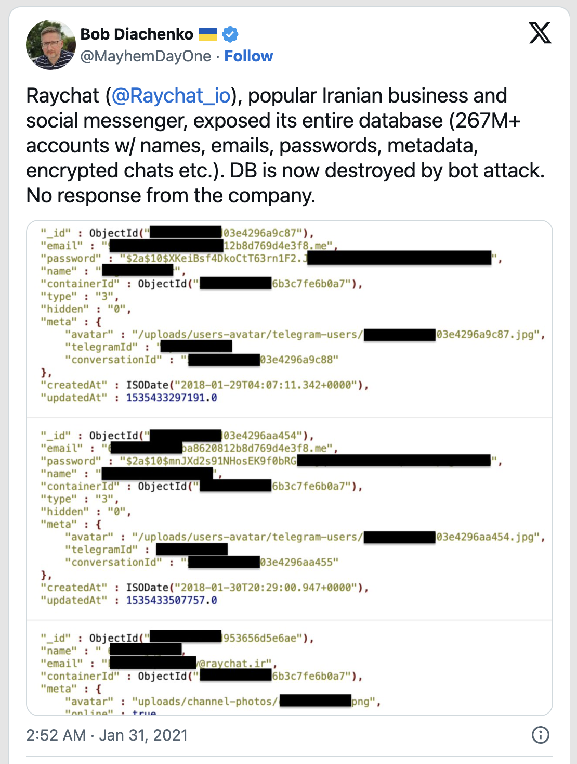
Remediations
P A R T 0 1
Stored its user data on a misconfigured MongoDB database(NoSQL database).
Discovered by security researcher Bob Diachenko.
Came across the vulnerability using publicly accessible open-source search tools.
Reached out to the company but says he initially got no response.

Slide 5
Remediations
P A R T 0 1
Raychat quickly admitted to the breach
Published a statement on its website and apologized to users for the inconvenience.
Co-founder Ghader Sadeghi confirmed in a message that Diachenko had been helpful in assessing the nature of the breach.
Stressed the company’s remorse to its users and its willingness to improve.
User data is backed up and will be restored shortly.
In Jan.31, the company warned users to change their password through email.

Slide 6
The Impacts
P A R T 0 2

Slide 7

Direct Impact
P A R T 0 2
Data Breach:
The most immediate and direct impact was the data breach itself, leading to the unauthorized access and exposure of user data. This included 267 million usernames, emails, passwords, metadata, and encrypted chats.
Financial:
Direct costs: related to identifying and addressing the breach, legal fees, potential fines for compliance failures, and any ransom that might have been paid.
Indirect costs: Increased security costs, business interruption and lost revenue during and after the breach.
Operational Disruption:
Service Downtime: The bot attack that erased the company’s data would have caused a shutdown of Raychat's services.
Customer Support Challenges: With the loss of data, customer support services would struggle to operate normally,and decreased customer satisfaction.

Slide 8

Indirect Impact
P A R T 0 2
Impact on Future Business Opportunities:
The breach could affect future partnerships, investor relations, and expansion opportunities. Companies involved in data breaches often find it more challenging to engage in business deals, as trust and security become major concerns for potential partners.
Legal and Regulatory Consequences:
Depending on the jurisdiction and the nature of the data exposed, Raychat might have faced legal actions from individuals or regulatory penalties for failing to protect user data.
Reputation Damage:
The trust of users and potential users was likely eroded, which can have long-term effects on user retention and acquisition. A loss in trust can significantly impact a company's market position, especially in competitive sectors.
Loss in Market Value
Customer Churn

Slide 9
Recommendations
P A R T 0 3

Slide 10
Recommendations
Immediate Responses
Investigation
Incident Containment
Temporary shut down affected systems which prevent further damage and isolate the compromised elements of the network
Communication
Inform affected users and stakeholders about the breach immediately and provide clear information on what happened, the potential impact, and the steps taken in response
Data Breach Analysis
Identify the specific data that was compromised and assess the potential impact on users and the company
Legal Compliance
Ensure all responses are in compliance with local and international data protection regulations, which can involve notifying regulatory bodies and affected individuals

Slide 11
Cause:
“Misconfigured server”
Automated Configuration Management
Utilize automated configuration management tools
Ensure consistent and secure configurations across all servers in the cloud environment
Enforce security policies, detect misconfigurations, and remediate them promptly
Security Best Practices
Follow the established security best practices for server configuration
Disabling unnecessary services, limiting user privileges, and applying least privilege principles
Regularly review and update security configurations to align with evolving threats and industry standards
Ongoing Training and Awareness
Educate IT administrators and cloud infrastructure teams on the importance of secure server configurations and the potential risks associated with misconfigurations
Provide training on how to properly configure and secure servers in alignment with organizational security policies and best practices.

Slide 12
Thank you for listening

